Slide 1
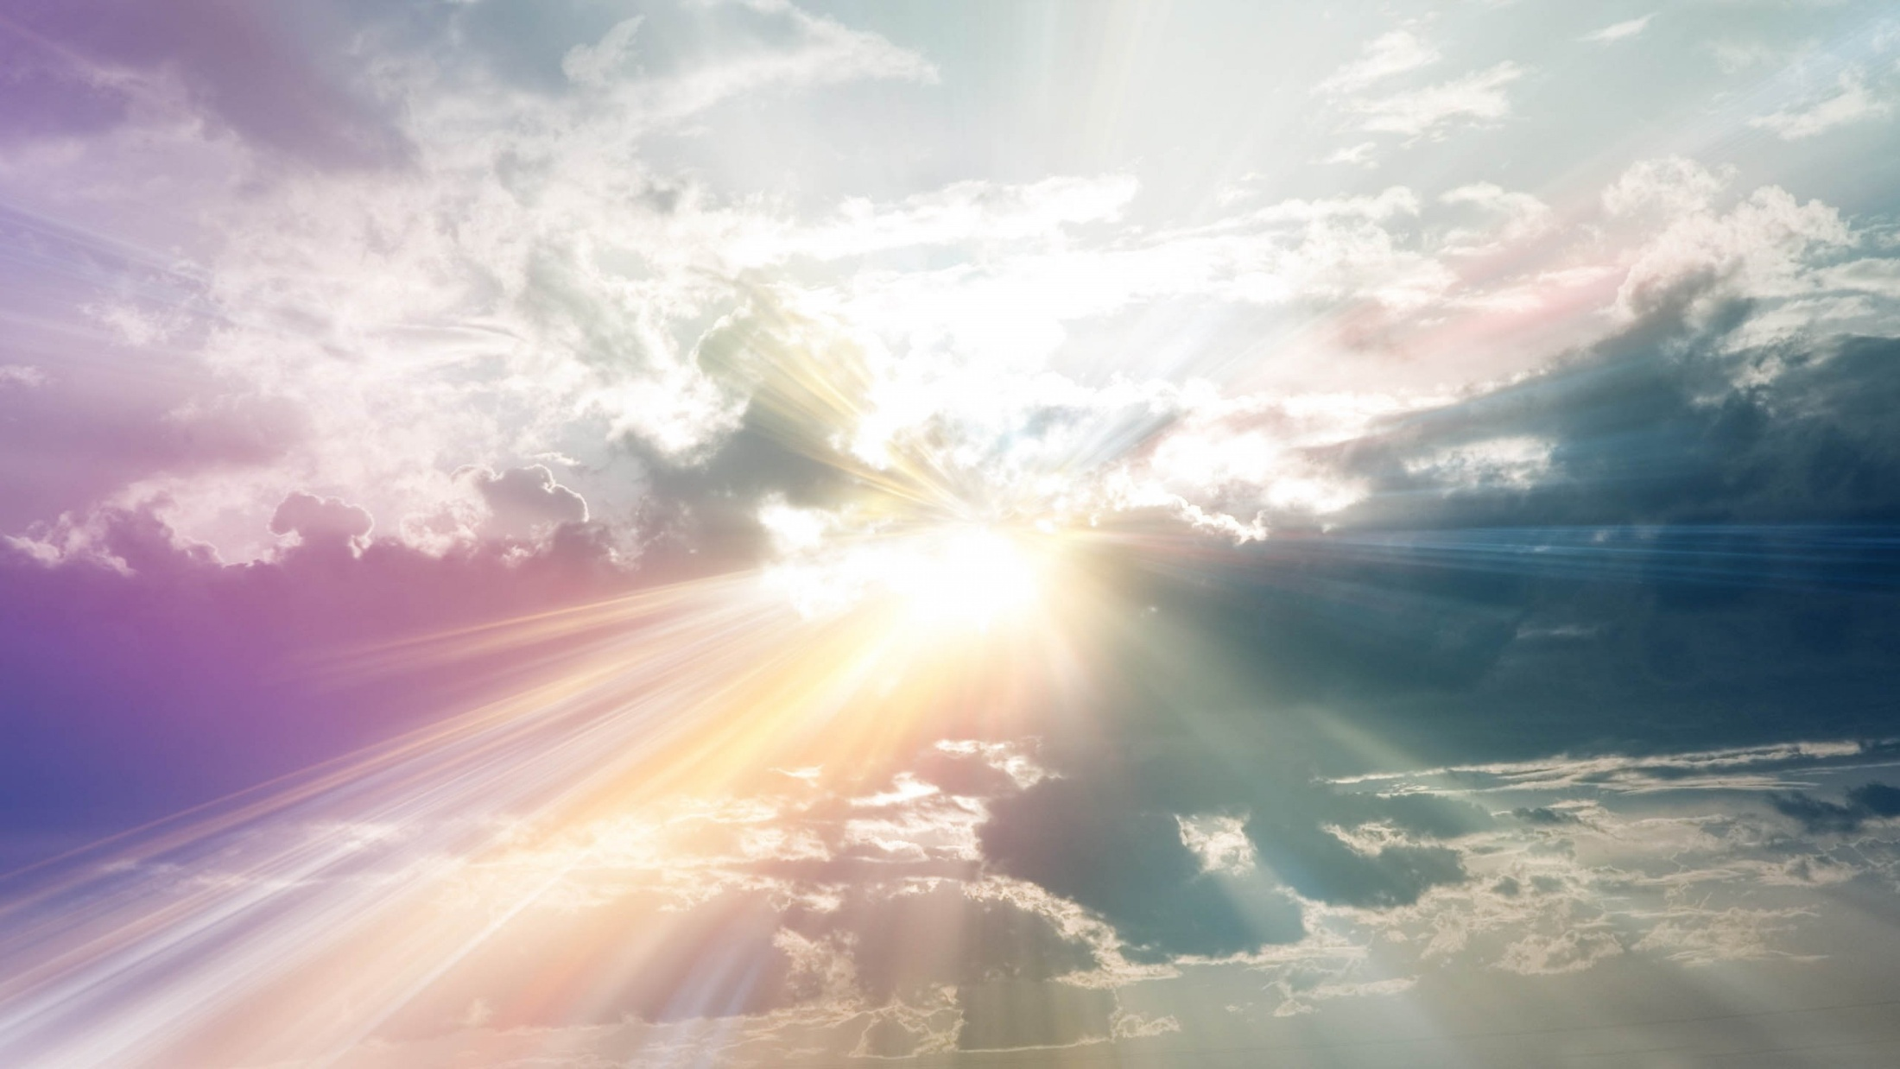
Perfect God. Imperfect People
Isaiah 6:1-5

Slide 2
Perfect God. Imperfect People
God: Perfect and Holy
Isaiah 6:1–3 I saw the Lord, high and exalted, seated on a throne; and the train of his robe filled the temple. ² Above him were seraphim, each with six wings: With two wings they covered their faces, with two they covered their feet, and with two they were flying.³ And they were calling to one another: “Holy, holy, holy is the Lord Almighty; the whole earth is full of his glory.”

Slide 3
Perfect God. Imperfect People
Isaiah 6:4-5
⁴ At the sound of their voices the doorposts and thresholds shook and the temple was filled with smoke. ⁵ “Woe to me!” I cried. “I am ruined! For I am a man of unclean lips, and I live among a people of unclean lips, and my eyes have seen the King, the Lord Almighty.”

Slide 4
Perfect God. Imperfect People
Jesus: Paid for our Sin
2 Corinthians 5:21 God made him who had no sin to be sin for us, so that in him we might become the righteousness of God.

Slide 5
Perfect God. Imperfect People
Isaiah 57:15
For this is what the high and exalted One says— he who lives forever, whose name is holy: “I live in a high and holy place, but also with the one who is contrite and lowly in spirit, to revive the spirit of the lowly and to revive the heart of the contrite.”

Slide 6
Perfect God. Imperfect People
Holy Spirit: Empowers us to live for God
Titus 3:4-6 ⁴ But when the kindness and love of God our Savior appeared, ⁵ he saved us, not because of righteous things we had done, but because of his mercy. He saved us through the washing of rebirth and renewal by the Holy Spirit, ⁶ whom he poured out on us generously through Jesus Christ our Savior.

Slide 7
Perfect God. Imperfect People
Romans 8:5-6
⁵ Those who live according to the flesh have their minds set on what the flesh desires; but those who live in accordance with the Spirit have their minds set on what the Spirit desires. ⁶ The mind governed by the flesh is death, but the mind governed by the Spirit is life and peace.

